Slide 1
Next generation sequencing workshop 1
Dr. Cheng Zhang
Senior Lecturer
King’s College London

Slide 2
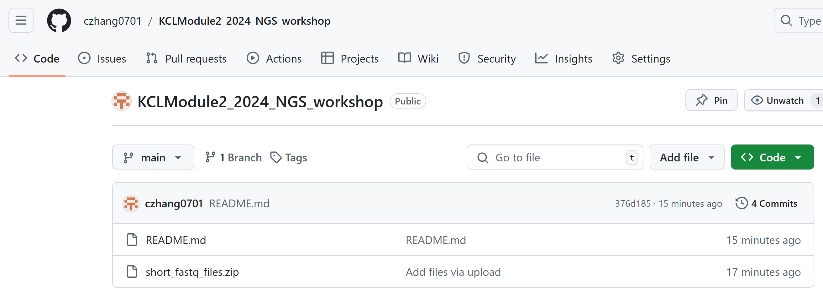
The Github
czhang0701/KCLModule2_2024_NGS_workshop (github.com)

Slide 3
Section 1: Quality control of fastq file
Log into Galaxy.
Upload the FASTQ files (short_file.fastq).
Search for the FastQC tool and run it on both FASTQ files.
View the generated reports and try to understand what’s in there.

Slide 4
What’s in the QC file?
What is GC Content?
GC content refers to the percentage of guanine (G) and cytosine (C) bases in your sequencing reads compared to the total bases (A, T, G, C).
Typical GC content for human DNA is around 40-45%, depending on the region of the genome and the species. Some regions (e.g., gene-dense areas) tend to have higher GC content, while others (e.g., regulatory regions) may have lower.

Slide 5
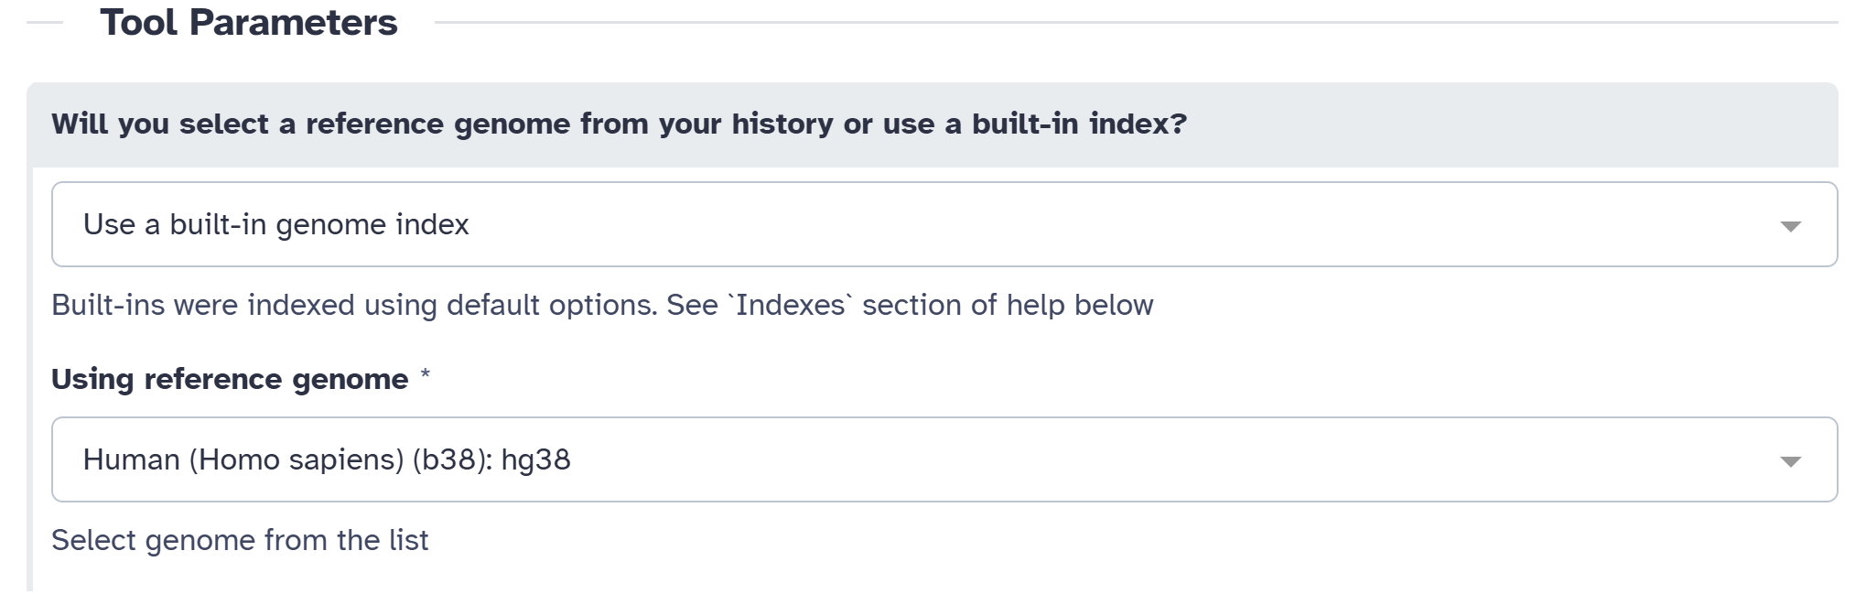
Section 2: Quality control of fastq file
In Galaxy, search for the BWA-MEM tool.
Input your FASTQ files and select the human hg38 as reference genome.
Run the alignment with default setting and generate a BAM file.
Once the job completes, inspect the BAM file by viewing it in the Galaxy interface.

Slide 6
Section 3: BAM File Visualization Using IGV Web
Go to the IGV Web App.
Upload the BAM file and the reference genome.
Explore the alignment, zoom in on specific regions, and inspect the coverage and read alignment patterns.

Slide 7
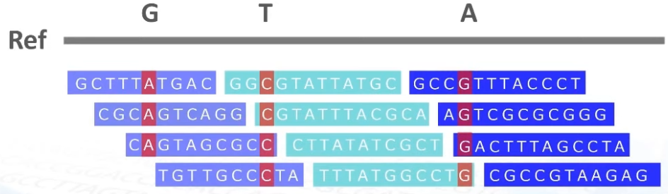
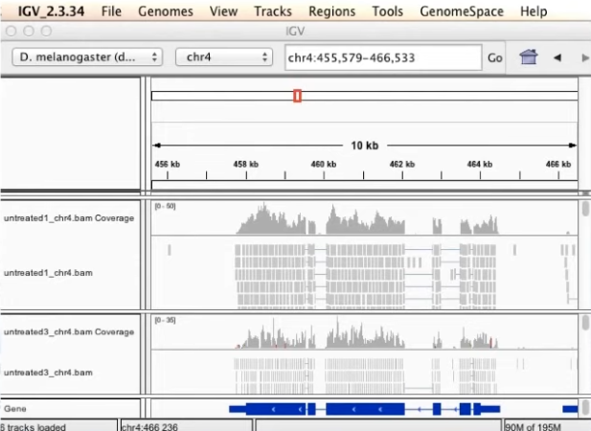
Genome sequencing data analysis
Which looks like this in the real world!

Slide 8

Pros
+ easy to use
+ fast
+ easy to share
+ can work both online (webtool) and offline
Cons
- computationally heavy for large data sets
- can only be ran on one computer at a time
Integrative
Genomics
Viewer
Access to IGV webtool: https://igv.org/app/
Access to IGV webtool tutorials:
https://www.youtube.com/watch?v=sFeK-25K5PE&t=210s
https://www.youtube.com/watch?v=HwvTcG2SEOs
8

Slide 9
Instructions:
Access IGV Web App:
Open IGV Web App in your browser.
Load the Reference Genome:
Click on Genome in the top menu and choose Human (GRCh38/hg38).
Upload BAM File:
Click on Track and select Load File.
Choose the BAM file output downloaded from the previous BWA alignment step.
Also load the BAM index file (.bai) from the previous step.
Inspect the Alignment:
Try to find reads mapped to genome file and guess how can you find the aligned reads.
9

